Slide 1

Operating system

Slide 3
Multilevel queue scheduling
Algo is suitable for processes that can be categorized into groups.
Here, ready queue is partitioned into multiple queues. For e.g.,
Foreground (Interactive)
Background (Batch)
Each queue follows its own scheduling algorithm

Slide 4
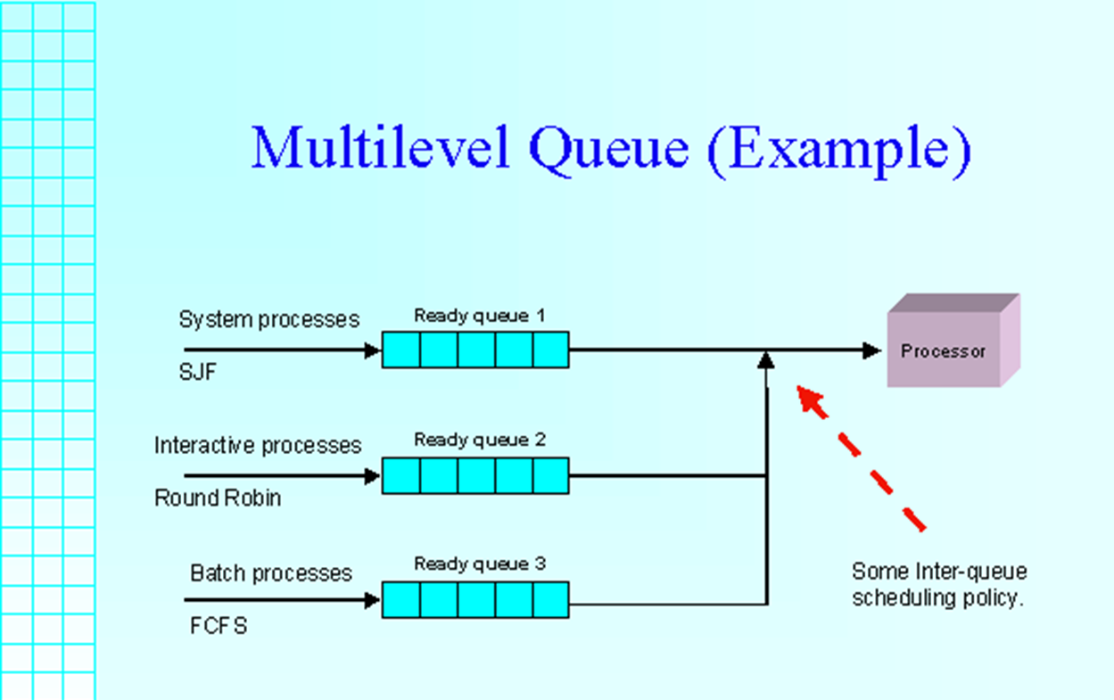
Multilevel queue scheduling
IMG SRC: https://slideplayer.com/slide/14919762/

Slide 5
Multilevel queue scheduling
Inter-queue scheduling is required.
For example:
fixed priority scheduling (lead to starvation)
Time slice for queues: 80% to interactive and 20% to batch

Slide 6
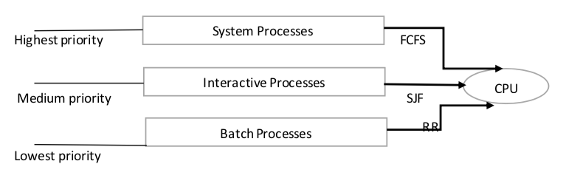
Multilevel queue scheduling
IMG SRC: https://tutorialwing.com/multilevel-queue-scheduling-tutorial-with-example/

Slide 7
Multilevel FEEDBACK queue scheduling
Usually, processes do not move between queues because of predefined priorities
Advantage: Low scheduling overhead
Disadvantage: Inflexible
Multilevel Feedback Scheduling allows a process to move between queues

Slide 8
Multilevel FEEDBACK queue scheduling
Multilevel Feedback Queue Scheduler is defined by following parameters:
Number of queues
Scheduling algo for each queue
Method to determine when to upgrade a process
Method to determine when to demote a process
Method to determine which queue a process will enter when that process needs service

Slide 9
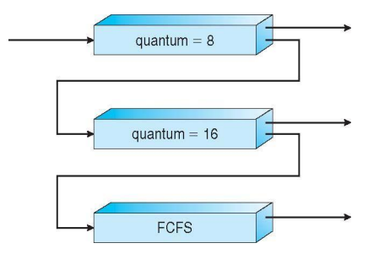
Multilevel FEEDBACK queue : Example
Three queues:
Q0 – RR with time quantum 8ms
Q1 – RR time quantum 16ms
Q2 – FCFS
Scheduling:
A new job enters queue Q0 which is served FCFS
When it gains CPU, job receives 8 milliseconds
If it does not finish in 8 milliseconds, job is moved to queue Q1
At Q1 job is again served FCFS and receives 16 additional milliseconds
If it still does not complete, it is preempted and moved to queue Q2
Aim: Preference given to short lived processes

Slide 10
Content
Inter Process Communication (IPC)
Process Synchronization
IPC Methods

Slide 11
What is Inter Process Communication (IPC)
Definition: “Inter-process communication is used for exchanging useful information between numerous threads in one or more processes (or programs).”
In general, Inter Process Communication is a type of mechanism usually provided by the operating system (or OS). The main aim or goal of this mechanism is to provide communication between several processes.

Slide 12
What is Process Synchronization ?
S
When two or more process cooperates with each other, their order of execution must be preserved otherwise there can be conflicts in their execution and inappropriate outputs can be produced.
On the basis of synchronization, processes are categorized as one of the following two types:
Independent Process: Execution of one process does not affect the execution of other processes.
Cooperative Process: Execution of one process affects the execution of other processes.
Note: Process synchronization problem arises in the case of Cooperative process because resources are shared in Cooperative processes.

Slide 13
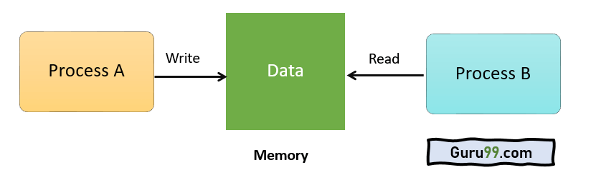
Example:
S
A process A tries changing data in a particular memory location. At the same time another process B tries reading data from the same memory location. Thus, there is a high probability that the data being read by the second process is incorrect.
Need for Synchronization-
When multiple processes execute concurrently sharing some system resources.
To avoid inconsistent results.

Slide 14
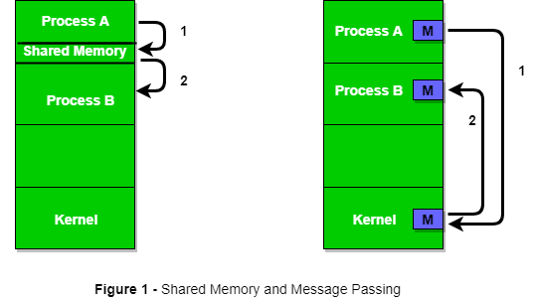
IPC Methods
The communication between these processes can be seen as a method of cooperation between them. Processes can communicate with each other through-
Shared Memory
Message Passing

Slide 15
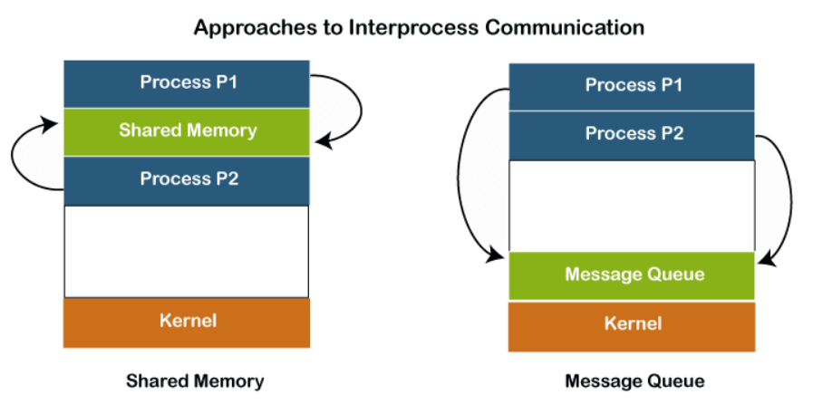
Shared Memory Method
It can be referred to as a type of memory that can be used or accessed by multiple processes simultaneously.
Several different processes are allowed to read and write the data to the message queue. In the message queue, the messages are stored or stay in the queue unless their recipients retrieve them.

Slide 16
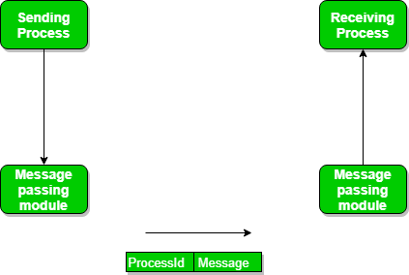
Message Passing Method
It is a type of mechanism that allows processes to synchronize and communicate with each other. However, by using the message passing, the processes can communicate with each other without restoring the shared variables.
The IPC mechanism provides two operations that are as follows: send and receive

Slide 17
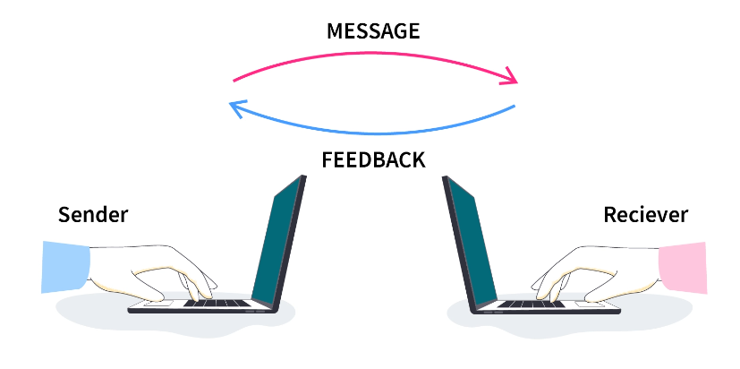
Communication Link for message passing
Direct Communication Link- A link is created or established between two communicating processes. For every pair of communicating processes, only one link can exist.
Indirect Communication Link- When processes share a common mailbox, and each pair of these processes shares multiple communication links. These shared links can be unidirectional or bi-directional.

Slide 18
Advantages of Inter Process Communication (IPC)
It helps to speedup modularity
Ease Computations
Process synchronization
Convenience
Helps the operating system to communicate among processes and synchronize their actions as well.

Slide 19
Thank You

